Slide 1

In-Country Working Session: FASTR Implementation & RMNCAH-N Service Monitoring Analysis
January 27-30, 2026 | Lusaka

Slide 2
Agenda
Time | Agenda | Facilitator/Presenter
Opening Session
08:30-09:00 | Participant registration | MoH team
09:00-09:10 | Welcome and opening remarks | MoH team
09:10-09:20 | Icebreakers/Introductions | MoH team
09:20-09:35 | Overview of agenda, workshop objectives | GFF FASTR team
Session 1: Overview of the FASTR approach
09:35-10:30 | Overview: FASTR Approaches | GFF FASTR team
Session 2: HMIS data extraction
10:30-11:30 | Data extraction: Rationale and methods | GFF FASTR team
Session 3: Introduction to the FASTR analytics platform
11:30-12:30 | Introduction to the FASTR analytics platform | GFF FASTR team
12:30-14:00 | Lunch Break
14:00-14:30 | Getting participants into the platform | GFF FASTR team
Session 4: Configuring the FASTR analytics platform
14:30-16:30 | Configuring the analysis platform | GFF FASTR team

Slide 3
Agenda
Time | Agenda | Facilitator/Presenter
09:00-09:15 | Overview of Day 2 agenda | GFF FASTR team
Session 5: Overview of FASTR methods and analytical outputs
09:15-10:15 | Data quality, service utilization, coverage | GFF FASTR team
Session 6: Creating a project
10:15-11:15 | Project creation and settings | GFF FASTR team
Session 7: Creating visualizations
11:15-12:30 | Creating and editing visualizations | GFF FASTR team
12:30-14:00 | Lunch Break
Session 8: Creating reports
14:30-16:30 | Practice creating and editing reports | GFF FASTR team

Slide 4
Agenda
Time | Agenda | Facilitator/Presenter
09:00-09:15 | Overview of Day 3 agenda | GFF FASTR team
Session 8: Interpretation of visualizations
09:15-10:15 | Approaches to support interpretation | GFF FASTR team
Session 9: Creating a Q4 2025 report
10:15-12:30 | Creating short and long reports with country context | GFF FASTR team
12:30-14:00 | Lunch Break
Session 9 (cont'd): Creating a Q4 2025 report
14:00-15:00 | Continue report creation with country context | GFF FASTR team
Session 10: Presenting reports
14:30-15:30 | Present reports, group feedback | GFF FASTR team

Slide 5
Agenda
Time | Agenda | Facilitator/Presenter
09:00-09:15 | Overview of Day 4 agenda | GFF FASTR team
Session 12: Overview of FASTR HFA phone survey
09:15-10:15 | HFA overview and questionnaire adaptation guidelines | GFF FASTR team
Session 13: Questionnaire adaptation to the Zambian context
10:15-12:30 | Review questionnaire + hands-on adaptation | GFF FASTR team
12:30-14:00 | Lunch Break
Session 14: Questionnaire adaptation (cont'd)
14:00-15:00 | Continue questionnaire adaptation (in groups) | GFF FASTR team
Session 15: Discussion: HFA adapted questionnaire
14:30-15:30 | Discuss adapted questionnaire in plenary | GFF FASTR team
Session 16: Discussion: HFA priorities and data use
15:30-16:30 | HFA priorities and data use case in Zambia | GFF FASTR team
Session 17: Action planning and wrap-up
16:30-17:00 | Key messages and wrap-up | GFF FASTR team

Slide 6
Workshop Objectives
• Prepare MoH for participation in the multi-country workshop
• Strengthen capacity for disruption analysis and data extraction
• Configure the FASTR analytics platform for Zambia
• Produce the first quarterly report
• Adapt the phone survey questionnaire to the Zambian context
• Use data downloader tools for DHIS2

Slide 7
Scope of Work
Disruption Analysis Activities
• Data extraction and configuration of analytics platform
• Produce first quarterly report
• Review results and contextualize findings (with relevant program teams)
Phone Survey Activities
• Adaptation of questionnaire (with program input)
Capacity Building
• Training on data downloader for all with DHIS2 access
• Hybrid format: face-to-face and online

Slide 8
Expected Outputs
• Adapted phone survey questionnaire
• First quarterly report draft
• Trained MoH team on data downloader tools
• Roadmap for participation in Abuja workshop

Slide 9
Session 1: Overview of the FASTR approach

Slide 10
Introduction to FASTR

Slide 11
What FASTR does with routine HMIS data

Slide 12
Why rapid-cycle analytics?
• Timely insights aligned with country decision cycles
• Continuous learning rather than one-off assessments
• Direct feedback loops between data, analysis, and action

Slide 13
Focus of the analysis
Core indicators
FASTR prioritizes a core set of RMNCAH-N indicators that:
• Represent key service delivery contacts across the continuum of care
• Have relatively high reporting completeness and volumes
• Serve as proxies for broader service delivery performance
Outpatient consultations are included as a proxy for overall health service use. The indicator set can be expanded to reflect country-specific priorities.
Core data quality metrics
Analysis is anchored in a standardized set of data quality metrics, including:
• Reporting completeness
• Extreme value (outlier) detection
• Consistency across related indicators
These metrics are summarized into an overall data quality score to support interpretation and comparison across areas.

Slide 14
FASTR approach to routine data analysis
The FASTR approach follows a three-step workflow:
1. Assess data quality
Identify issues related to completeness, outliers, and internal consistency at national and subnational levels.
2. Adjust for data quality limitations
Apply transparent, indicator-specific corrections to improve the reliability of trend analysis.
3. Analyze service delivery
Quantify changes in priority service volumes and compare coverage trends against country targets.
This enables continuous, subnational monitoring while data quality is systematically improved.

Slide 15
Session 2: HMIS data extraction

Slide 16
Why extract data from DHIS2?
Data quality adjustment
The FASTR approach focuses on data quality adjustments to expand the analyses countries can do with DHIS2 data and to generate more robust estimates.
The FASTR methodology includes specific approaches to:
• Identify and adjust for outliers
• Adjust for incomplete reporting
• Apply consistent data quality metrics
These adjustments require processing that cannot be done within DHIS2's native analytics.

Slide 17
Why extract data from DHIS2?
Analysis complexity
The FASTR approach uses more advanced statistical methods, such as regression analysis, which are not available in DHIS2. While DHIS2 can plot trends over time using raw data, FASTR can go further by:
• Identifying significant increases or decreases in service volume
• Adjusting for data quality issues
• Accounting for expected seasonal variations
• Comparing key periods, such as before and after a reform
The choice between DHIS2 and the FASTR approach should be guided by the specific purpose of your analysis.

Slide 18
Data format and granularity
Data should be downloaded for each indicator of interest, at facility level, and monthly for the period of interest.
• Data should be saved in long format meaning each row represents a single observation or measurement
• Data should be saved in .csv format and can be saved in either a single .csv file or multiple .csv files
Why monthly facility level data?
We want to use the most granular data we have access to in order to make more fine tuned assessments for data quality. Using monthly facility level data allows us to conduct the most robust analysis.

Slide 19
Key variables
Element | Description
Org units | Organizational unit identifier
Period | Time period of the data
Indicator name | Name of the indicator
Total/count | The aggregated value

Slide 20
How much data?
Initial FASTR analysis
• Download approximately five years of historical data
• Exact period depends on data availability and consistency in indicator definitions
Routine update to FASTR analysis
• Download new data covering the most recent months not previously included (usually three months for quarterly implementation)
• Include the three preceding months as recent data is often subject to changes due to late reporting or data quality adjustments

Slide 21
Data extraction tools
We offer two tools for bulk DHIS2 data extraction:
API Script (Google Colab)
• Input login credentials, specify timeframes, indicators, and administrative levels
• Download data as a .csv file
Data Downloader
• More intuitive, streamlined interface
• Recommended for most users
Both tools enable efficient data extraction, and we provide training resources to support their use.

Slide 22
DHIS2 Data Downloader
The Data Downloader is a desktop application for extracting data from DHIS2.
Key features:
• Connect to any DHIS2 instance
• Browse and select data elements and indicators
• Download facility-level data in CSV format
• Maintain download history
Download from GitHub:
https://github.com/worldbank/DHIS2-Downloader/releases/
Facilitator will demonstrate the Data Downloader

Slide 23
Session 3: Introduction to the FASTR analytics platform

Slide 24
Introduction to the FASTR Analytics Platform
The FASTR analytics platform is a web-based tool for data quality assessment, adjustment, and analysis of routine health data.
Key features:
• Upload and analyze data from DHIS2 and other sources
• Built-in statistical methods for data quality adjustment
• User-friendly interface for running analyses
• Flexible visualization and export options
In this session, we will provide a conceptual walkthrough of the platform and its capabilities.

Slide 25
Live Demo: Platform Access & Roles
In this demo, we will:
• Navigate to the FASTR platform
• Explore user roles: Administrator, Editor, Viewer
• Review user management and permissions
• Understand the workflow for uploading data and making analytical decisions
Facilitator will demonstrate in the live platform

Slide 26
Lunch Break
90 minutes • Back at 14:00

Slide 27
Session 4: Configuring the FASTR analytics platform

Slide 28
Activity: Setting Up Admin Areas
In this hands-on session, we will configure:
• Admin areas (regions, districts)
• Facility structure
• Indicator definitions
Participants will work directly in the platform

Slide 29
Activity: Importing Data
In this hands-on session, we will:
• Review data format requirements
• Walk through the import process
• Handle validation and error checking
Participants will import their country's data

Slide 30
Activity: Installing and Running Modules
In this hands-on session, we will:
• Review available analysis modules
• Install required modules
• Run initial analyses
Participants will configure and run modules on their data

Slide 31
Day 2

Slide 32
Recap
On Day 1, we covered:
• The FASTR approach and rapid-cycle analytics methodology
• Data extraction from DHIS2 using the Data Downloader
• Introduction to the FASTR Analytics Platform
• Platform configuration: admin areas, data import, modules

Slide 33
Day 2 Focus
Today we will:
• Explore FASTR methods for data quality and analysis
• Create and configure projects
• Build visualizations
• Generate reports

Slide 34
Session 5: Overview of FASTR methods and analytical outputs

Slide 35
FASTR Analytical Pipeline

Slide 36
Data quality assessment
Understanding the reliability of routine health data

Slide 37
Why talk about data quality?
The challenge: Health facilities report data every month, but sometimes:
• Numbers seem too high or too low
• Facilities forget to report
• Related numbers don't match up
The impact: Bad data leads to bad decisions
• We might think services are improving when they're not
• We might miss real problems in certain areas
• Resources might go to the wrong places
FASTR's solution: Check data quality systematically, fix what we can, and be transparent about limitations

Slide 38
Objectives of FASTR Data Quality Assessment
Objective 1: Analytical adjustment
Assessing data quality allows you to adjust for data quality issues, improving the ability to use DHIS2 data for decision-making
Objective 2: Monitor data quality over time
Key learning questions include:
• What is the quality of data for different indicators in DHIS2? (can inform indicators you select for analysis)
• Which areas report higher vs. lower quality data? (can inform targeted data quality validation and supportive supervision)
• How has data quality improved over time? (can assess the result of data quality investments, training, etc.)

Slide 39
Three simple questions about data quality
1. Are facilities reporting regularly?
• Completeness: Did we get reports from facilities this month?
2. Are the numbers reasonable?
• Outliers: Are there any suspiciously high values?
3. Do related numbers make sense together?
• Consistency: Do related services show expected patterns?
These three questions help us understand if we can trust the data for decision-making.

Slide 40
Question 1: Are facilities reporting?

Slide 41
Completeness: Did we get reports?
What we're checking:
Each month, are facilities sending in their reports?
Why it matters:
• Missing reports = incomplete picture
• Apparent drops may just be missing data

Slide 42
What's good completeness?
It depends on your health system:
• 90%+ is excellent
• 80-90% is good
• Below 80% means we're missing a lot of information
Important: Even 100% completeness doesn't mean we have the full picture - some services might happen outside facilities or some facilities might not be in the reporting system.
What to look for: Is completeness improving over time? Which areas have low completeness?

Slide 43
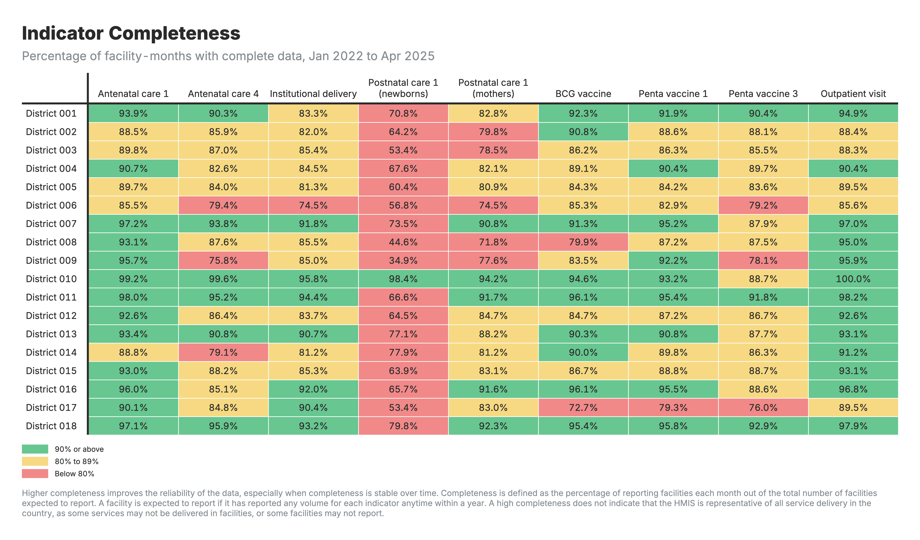
Completeness: FASTR output

Slide 44
Question 2: Are numbers reasonable?

Slide 45
Outliers: Spotting suspicious numbers

Slide 46
How we spot outliers
Outliers are identified by assessing the within-facility variation in monthly reporting for each indicator.
A value is flagged as an outlier if it meets EITHER of two criteria:
• A value greater than 10 times the Median Absolute Deviation (MAD) from the monthly median value for the indicator, OR
• A value for which the proportional contribution in volume for a facility, indicator, and time period is greater than 80%
AND for which the count is greater than 100.

Slide 47
Outlier example
Month | Tests Reported | Normal?
January | 245 | Normal
February | 267 | Normal
March | 2,890 | Outlier
April | 256 | Normal

Slide 48
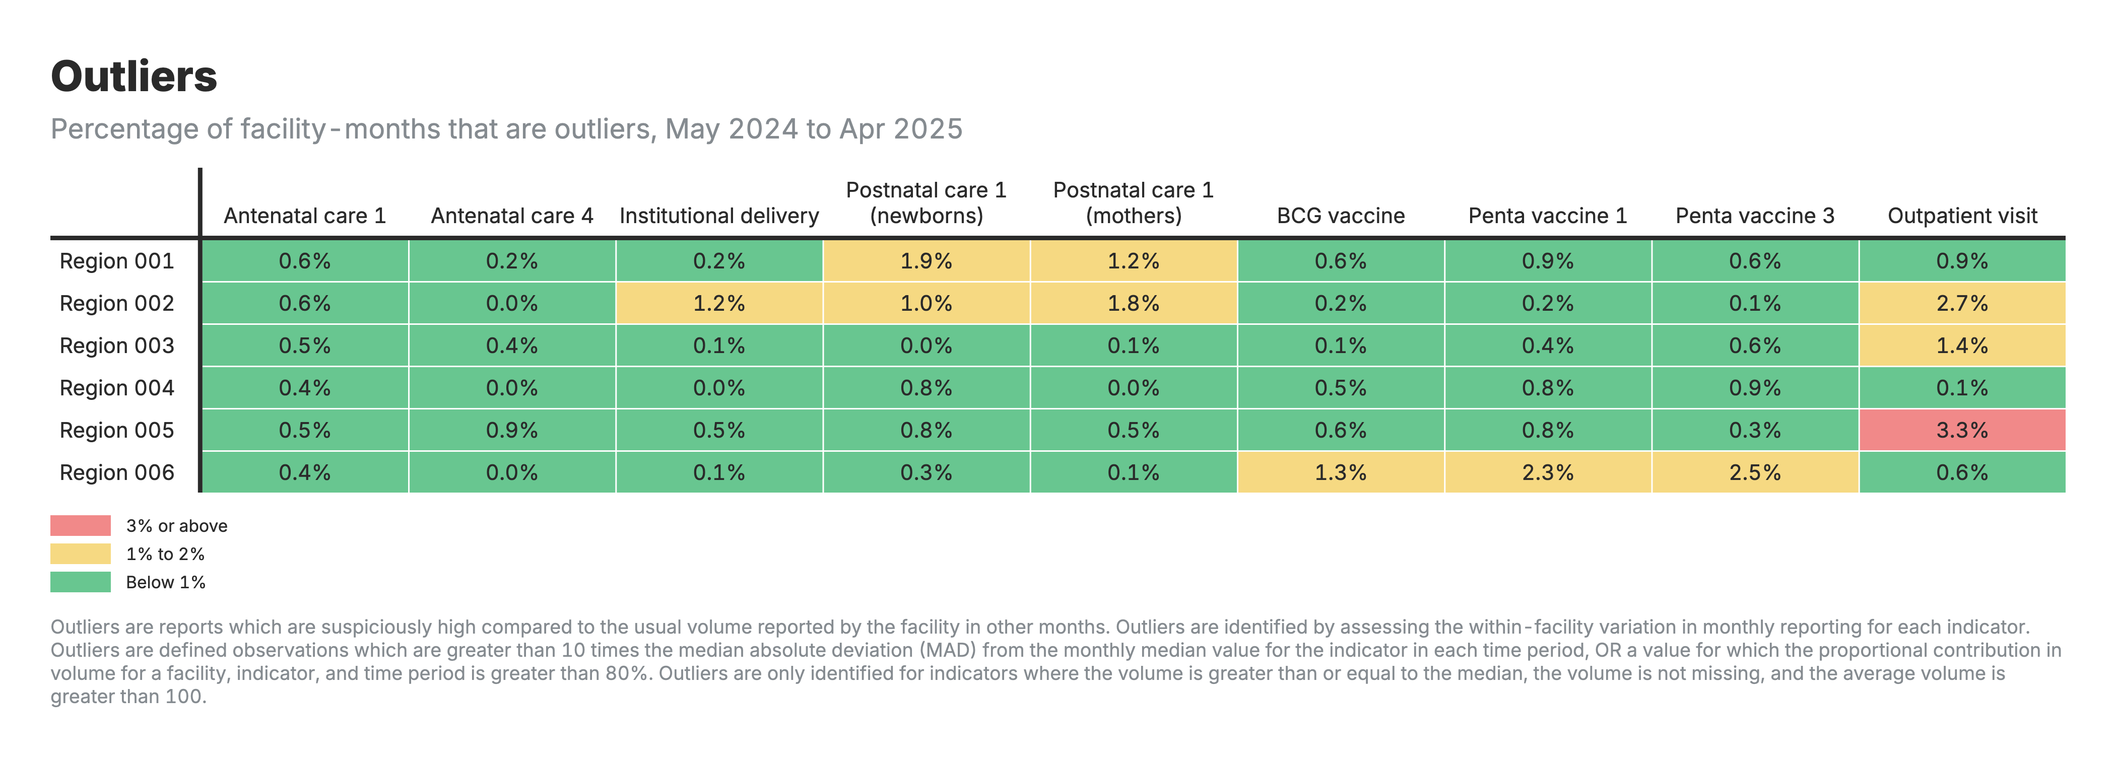
Outliers: FASTR output

Slide 49
Question 3: Do related numbers match up?

Slide 50
Consistency: Do related services make sense together?
What we're checking:
Health services are related - certain patterns are expected.
Example 1 - ANC visits:
• More women should get their 1st ANC visit (ANC1)
• Fewer should complete all 4 visits (ANC4)
• We expect: ANC1 >= ANC4
Example 2 - Vaccinations:
• More babies should get their 1st Penta dose (Penta1)
• Fewer should complete all 3 doses (Penta3)
• We expect: Penta1 >= Penta3
If these relationships are backwards, something's wrong with the data.

Slide 51
Why check consistency at district level?
Patients move between facilities:
• Woman might get ANC1 at Health Center A
• But deliver at District Hospital B
• If we only look at each facility separately, numbers might not match
Solution: Check consistency at district level
• Add up all ANC1 visits in the district
• Add up all ANC4 visits in the district
• Compare the totals
This accounts for patients visiting different facilities for different services.

Slide 52
Consistency example
This passes the consistency check:
• More women started ANC (5,200) than completed 4 visits (4,100)
• This is logical - not everyone completes all visits
If it was reversed (ANC4 > ANC1), we'd know there's a data quality problem.

Slide 53
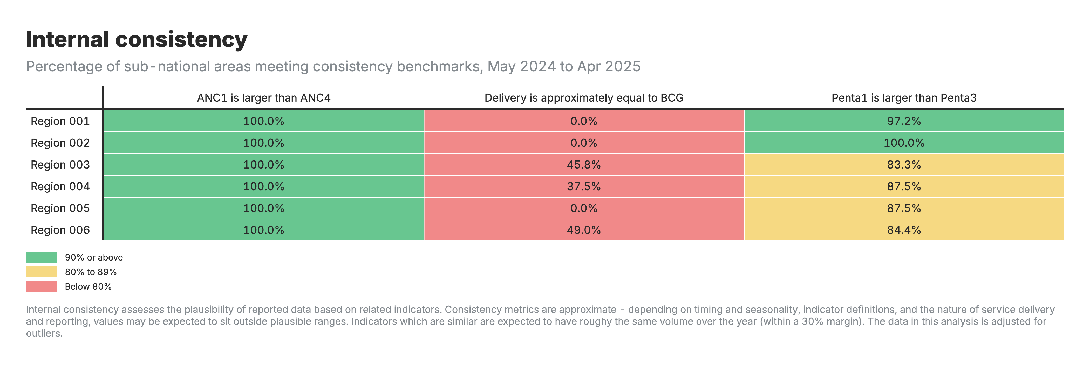
Consistency: FASTR output

Slide 54
Putting it all together: Overall data quality

Slide 55
Overall quality score
For each facility and month, we combine all three checks:
• Complete: Did the facility report?
• No outliers: Are the numbers reasonable?
• Consistent: Do related numbers make sense?
Binary DQA Score:
• dqa_score = 1 if ALL three checks pass
• dqa_score = 0 if ANY check fails
DQA Mean: Average of completeness-outlier score and consistency score
This helps us:
• Decide which data to use for analysis
• Identify facilities needing support

Slide 56
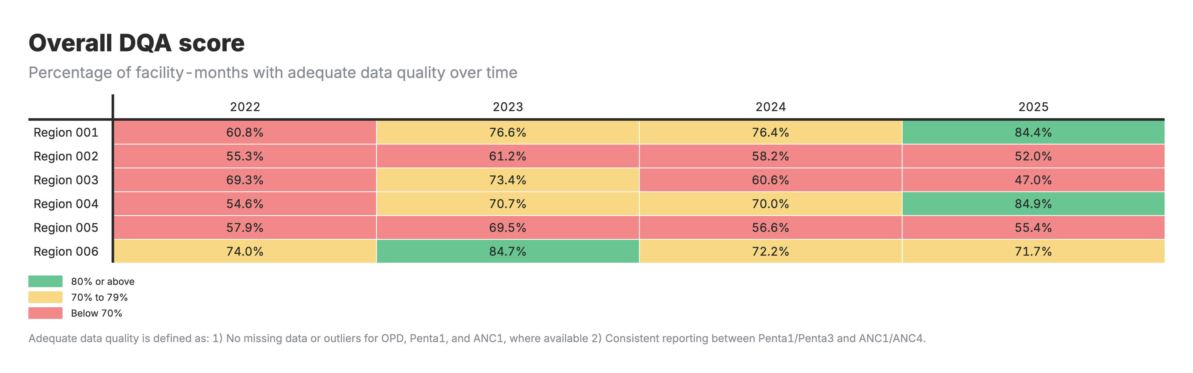
Overall DQA score: FASTR output

Slide 57
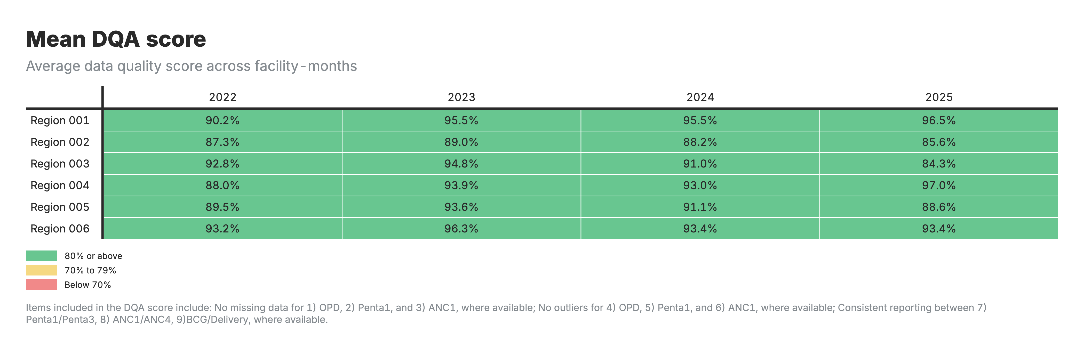
Mean DQA score: FASTR output

Slide 58
Approach to data quality adjustment
The FASTR analytics platform provides an option for adjusting data for outliers, indicator completeness, or both.

Slide 59
Adjustment for outliers
Position | Method | Example (outlier in June)
Middle | Centered average | Average of Mar-Apr-May + Jul-Aug-Sep
End | Backward average | Average of Jan-Feb-Mar-Apr-May-Jun (excluding outlier)
Start | Forward average | Average of Jul-Aug-Sep-Oct-Nov-Dec

Slide 60
Adjustment for completeness
Position | Method | Example (missing in June)
Middle | Centered average | Average of Mar-Apr-May + Jul-Aug-Sep
End | Backward average | Average of Jan-Feb-Mar-Apr-May
Start | Forward average | Average of Jul-Aug-Sep-Oct-Nov-Dec

Slide 61
Service utilization analysis
Monitoring changes in the volume of priority health services over time.

Slide 62
What we assess
Service utilization trends:
• Absolute yearly/quarterly volume for selected services
• Percent change over time
• Comparison across regions
Any year with more than a 10% change compared to the previous year is flagged for review.
Data can use: raw values, outlier-adjusted, completeness-adjusted, or both adjustments.

Slide 63
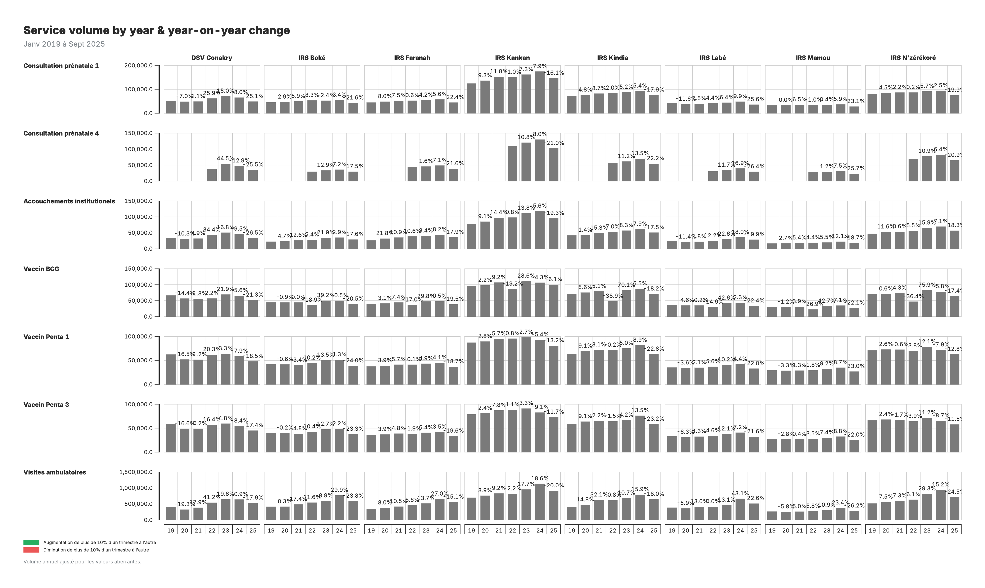
Service utilization: FASTR outputs

Slide 64
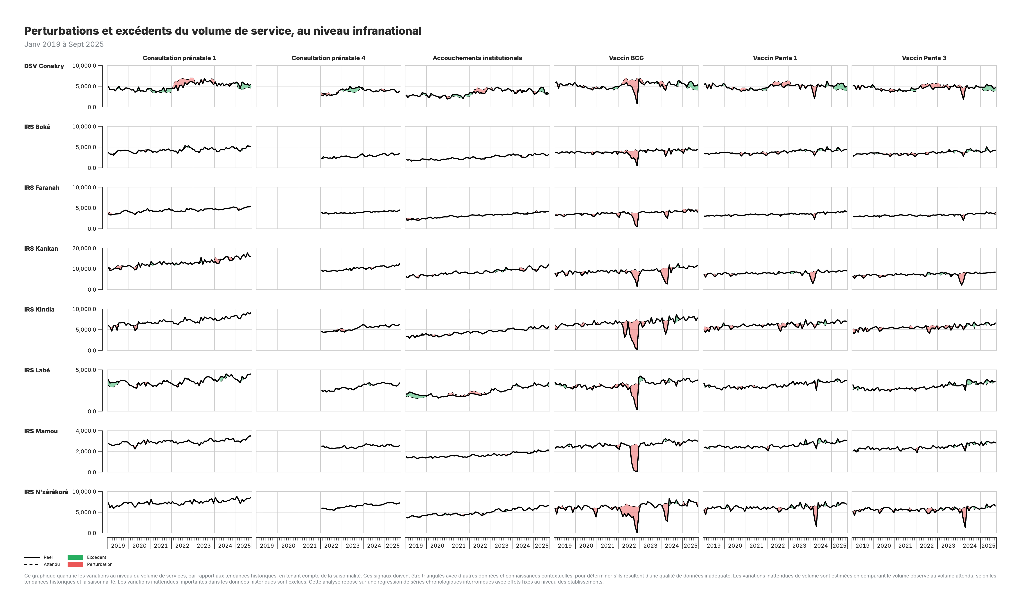
Service utilization: Subnational

Slide 65
DHIS2 vs FASTR comparison
Aspect | DHIS2 | FASTR
Data quality | Raw data | Adjusts for outliers and/or completeness
Visualization | Standard trend charts | Percent change to flag meaningful fluctuations
Analysis | Trends only | Trends + disruption quantification

Slide 66
Disruption analysis
Beyond simple trends, FASTR can detect and quantify service disruptions.
How it works:
• Model expected service volumes based on historical patterns and seasonality
• Compare actual volumes to expected volumes
• Quantify shortfalls or surpluses in absolute numbers

Slide 67
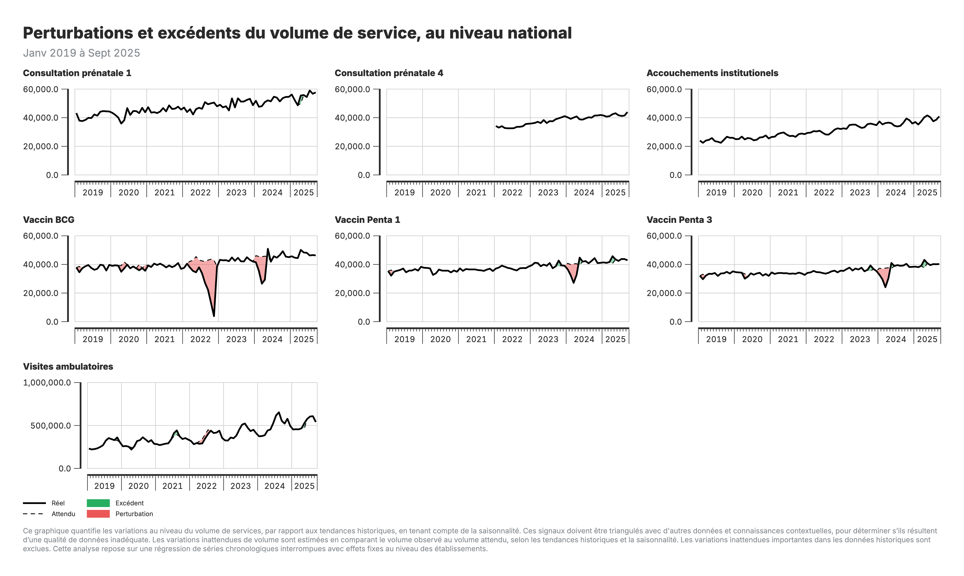
Disruption outputs

Slide 68
Service coverage estimates
The Coverage Estimates module (Module 4 in the FASTR analytics platform) estimates health service coverage by answering: "What percentage of the target population received this health service?"
Three data sources integrated:
• Adjusted health service volumes from HMIS
• Population projections from United Nations
• Household survey data from MICS/DHS

Slide 69
Two-part process
Part 1: Denominator calculation
• Calculate target populations using multiple methods (HMIS-based and population-based)
• Compare against survey benchmarks
• Automatically select best denominator for each indicator
Part 2: Coverage estimation
• Override automatic selections based on programmatic knowledge
• Project survey estimates forward using HMIS trends
• Generate final coverage estimates

Slide 70
What is service coverage?

Slide 71
Types of denominators for FASTR core analysis
Type of service | Denominator
ANC | Pregnancies
Delivery | Live births
BCG | Live births
Penta1 | Infants eligible for Penta (infants surviving 1+ months)
Penta3 | Infants eligible for Penta (infants surviving 1+ months)

Slide 72
Expected relationships which help with estimating denominators

Slide 73
Estimating denominators from ANC-1
Step | Formula | Example
Pregnancies | ANC1 count ÷ ANC1 coverage | 100,000 ÷ 0.95 = 105,263
Deliveries | Pregnancies × (1 - stillbirth rate) | 105,263 × 0.97 = 102,105
Live births | Deliveries × survival rate | 102,105 × 0.98 = 100,063

Slide 74
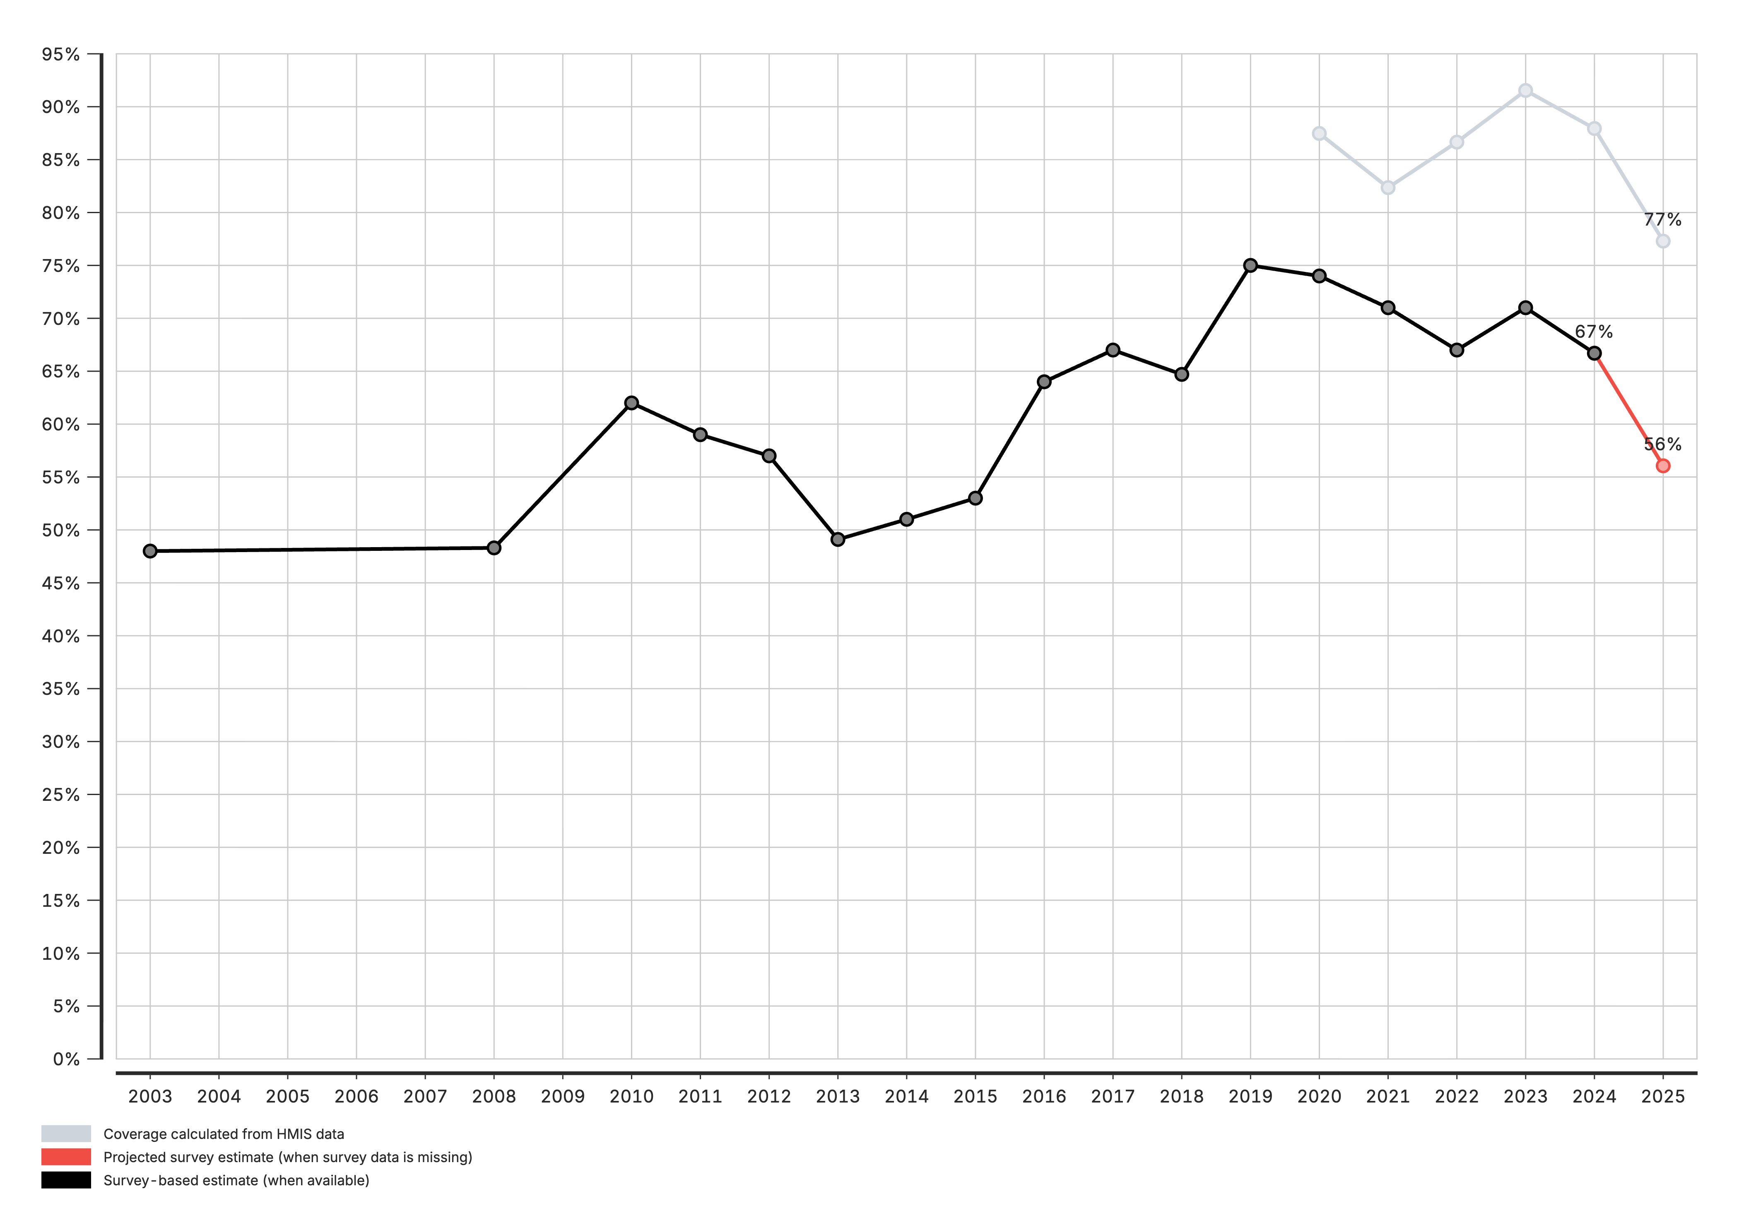
Coverage estimates: National level

Slide 75
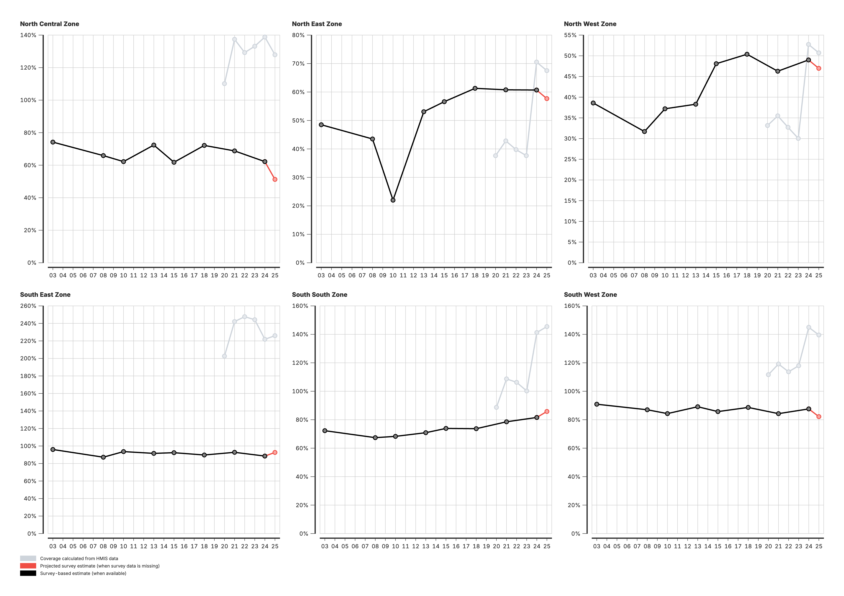
Coverage estimates: Admin area 2

Slide 76
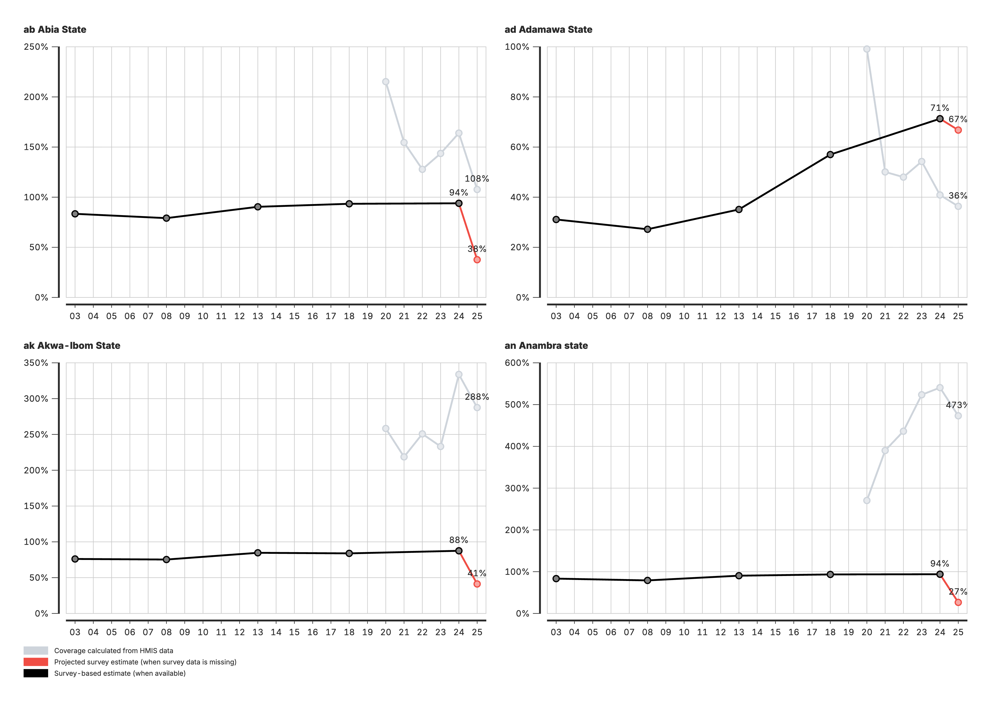
Coverage estimates: Admin area 3

Slide 77
Session 6: Creating a project

Slide 78
Activity: Creating a Project
In this hands-on session, we will:
• Set up a new project
• Configure project settings
• Select indicators and time periods
• Apply best practices for project organization
Participants will create their first project

Slide 79
Session 7: Creating visualizations

Slide 80
Activity: Creating Visualizations
In this hands-on session, we will:
• Explore available chart types
• Create and customize visualizations
• Export charts for use in reports
Participants will build visualizations from their analysis

Slide 81
Lunch Break
90 minutes • Back at 14:00

Slide 82
Session 8: Creating reports

Slide 83
Activity: Creating Reports
In this hands-on session, we will:
• Use report templates
• Generate automated reports
• Customize report content and layout
Participants will create their first quarterly report draft

Slide 84
Day 3

Slide 85
Recap
On Day 2, we covered:
• FASTR methods for data quality assessment and adjustment
• Creating and configuring projects in the platform
• Building visualizations from Zambia data
• Generating reports

Slide 86
Day 3 Focus
Today we move from analysis to action:
• Deep dive into interpretation of results
• Create the Q4 2025 quarterly report
• Present findings to the group
• Develop action plans for continued work

Slide 87
Session 8: Interpretation of visualizations

Slide 88
Analytical thinking & interpretation
Content to be developed
This section will cover:
• Frameworks for interpreting FASTR outputs
• Connecting data patterns to programmatic meaning
• Common interpretation pitfalls to avoid
• Building analytical thinking skills

Slide 89
Session 9: Creating a Q4 2025 report

Slide 90
Generating quarterly reporting products
Content to be developed
This section will cover:
• Quarterly reporting workflow
• Using the FASTR platform for automated reports
• Quality assurance for reports
• Distribution and feedback mechanisms

Slide 91
Lunch Break
90 minutes • Back at 14:00

Slide 92
Session 10: Presenting reports

Slide 93
End user mapping
End user mapping helps ensure that our outputs will meet the real needs of our end users.
Key questions
• Who is my end user?
• What does this end user need to accomplish with the report?
• What information are they most interested in?
• What do they like/not like about current reports?
• How do they like to receive their information?

Slide 94
Day 4

Slide 95
Recap
On Day 3, we covered:
• Interpretation of FASTR visualizations
• Creation of the Q4 2025 quarterly report
• Presentation of findings and group feedback
• Action planning for continued platform use

Slide 96
Day 4 Focus
Today we design the Health Facility Assessment:
• Overview of the FASTR HFA phone survey
• Review questionnaire structure
• Adapt questionnaire for Zambia context
• Plan HFA priorities and data use

Slide 97
Session 12: Overview of FASTR HFA phone survey

Slide 98
Health Facility Assessment Phone Survey
Complementing routine data with facility-level insights

Slide 99
Survey Objectives
The FASTR HFA phone survey is designed to:
• Monitor service availability, readiness, and functioning of PHC facilities over time (with emphasis on RMNCAH-N services)
• Characterize and assess effect of shocks on PHC functioning
• Inform and assess implementation of interventions for resilient PHC systems
• Enhance timeliness by supplementing large-scale in-person surveys with a rapid-cycle phone approach

Slide 100
Tool Design
Framework alignment:
• Aligned with WHO/UNICEF Primary Health Care Measurement Framework (2022)
Question sources:
• WHO Harmonized Health Facility Assessment
• WHO Service Availability and Readiness Assessment (SARA)
• World Bank Service Delivery Indicators (SDI)
• DHS Service Provision Assessment (SPA)
• USAID MOMENTUM
Implementation:
• Phone-based survey to facility managers/Officers in Charge
• Target duration: 30 minutes
• Quarterly contacts
• Modular design for flexibility

Slide 101
Why phone surveys?
Routine HMIS data tells us what is happening:
• How many services were delivered
• Which facilities reported
• Where there might be data quality issues
But HMIS data can't tell us why:
• Is the facility actually open?
• Are essential supplies available?
• Are trained staff present?
• What challenges are facilities facing?
Phone surveys fill this gap by contacting facilities directly to understand context.

Slide 102
What the survey covers
• Is the facility open and functioning?
• Which services are currently available?
• Are essential medicines in stock?
• What staff are present today?
• What challenges is the facility facing?
Results help explain why routine data might show certain patterns.

Slide 103
Questionnaire adaptation guidelines

Slide 104
Why adapt the questionnaire?
The standard FASTR questionnaire is a starting point, not a final product.
Every country needs to:
• Translate into local language(s)
• Use local health system terminology
• Focus on nationally relevant indicators
• Adjust for local facility types
• Match local supply/medicine names

Slide 105
Adaptation principles
Keep what matters:
• Core questions on operational status
• Essential supply availability
• Basic service provision
Adapt to context:
• Local terminology and naming
• Country-specific priority services
• Relevant response categories
Don't add too much:
• Phone surveys should stay short (15-30 min)
• Focus on actionable information
• Avoid "nice to know" questions

Slide 106
Session 13: Questionnaire adaptation to the Zambian context

Slide 107
Questionnaire structure and review
Note: Content generated with AI - human review needed

Slide 108
Survey blocks
Block | Content
A | Health Facility and Respondent Information
B | Shocks
B.1 | Resilience to Shocks
B.2 | Challenges in Past Three Months
C | Services
D | Infrastructure
E | Financing
F | Workforce and Staffing
G | Supplies
H | Leadership and Coordination
I | Community Engagement
J | Quality Improvement Processes

Slide 109
Review process
For each block, ask:
• Is this question relevant for our context?
• Is the wording clear in local language?
• Are the response options complete?
• Should we add country-specific items?
• Can we remove anything non-essential?
Goal: A questionnaire that is locally relevant while maintaining comparability with the FASTR standard.

Slide 110
Hands-on questionnaire adaptation
Note: Content generated with AI - human review needed

Slide 111
Activity overview
What we'll do:
Work in groups to adapt the standard FASTR questionnaire to our country context.
Groups:
• Group 1: Blocks A-B (Facility info, Shocks, Resilience, Challenges)
• Group 2: Blocks C-D (Services, Infrastructure)
• Group 3: Blocks E-F (Financing, Workforce)
• Group 4: Blocks G-J (Supplies, Leadership, Community, QI)

Slide 112
Adaptation checklist
For each question in your block:
• [ ] Is the question clear in local language?
• [ ] Are response options appropriate?
• [ ] Should we add country-specific items?
• [ ] Can we simplify without losing information?
• [ ] Does skip logic make sense?
Document your changes for group discussion.

Slide 113
Group discussion
After working in groups, we'll:
• Present adaptations - Each group shares key changes
• Discuss trade-offs - What did we add vs. remove?
• Reach consensus - Agree on final adaptations
• Plan pre-testing - How will we test the adapted questionnaire?

Slide 114
Lunch Break
90 minutes • Back at 14:00

Slide 115
Session 16: Discussion: HFA priorities and data use

Slide 116
HFA priorities and data use
Note: Content generated with AI - human review needed

Slide 117
Using survey results
Phone survey results should inform:
• Routine data interpretation
• Explain patterns in HMIS data
• Validate data quality concerns
• Targeted support
• Identify facilities needing intervention
• Prioritize supervision visits
• Supply chain management
• Track stockout patterns
• Inform distribution planning

Slide 118
Linking survey to routine data
HMIS pattern | Survey question | Insight
Facility stopped reporting | Is facility open? | Closed vs. reporting failure
Sudden drop in services | Stock availability? | Stockout impact
Low immunization numbers | Vaccine in stock? | Supply vs. demand issue

Slide 119
Next steps for HFA implementation
• Finalize adapted questionnaire
• Train enumerators
• Establish call schedule
• Conduct pilot round
• Analyze and link to HMIS
• Report and use findings
Key question: How will HFA results feed into your routine monitoring and decision-making processes?

Slide 120
Next Steps & Action Planning
Key actions to take after this working session:
• Finalize adapted phone survey questionnaire
• Complete first quarterly report draft
• Train remaining MoH team on data downloader tools
• Prepare roadmap for participation in Abuja workshop

Slide 121
Quarterly Reporting Cycle
Establish a sustainable reporting rhythm:
• Define quarterly report timeline and responsibilities
• Set up data extraction schedule
• Establish review and approval process
• Plan dissemination to stakeholders

Slide 122
Continued Platform Usage
Maintain momentum with the FASTR platform:
• Regular data updates and quality checks
• Expanding analysis to additional indicators
• Building capacity across MoH teams
• Documentation of lessons learned

Slide 123
Workshop Closing
Thank you for your participation!
Over the past four days, we have:
• Configured the FASTR platform for Zambia
• Created the first quarterly RMNCAH-N report
• Adapted the HFA questionnaire for local context
• Built capacity for ongoing analysis and reporting

Slide 124
Stay Connected
Continue the journey:
• Platform access and support
• Quarterly report submissions
• Multi-country workshop in Abuja
• Ongoing technical assistance from GFF team

Slide 125
Thank You
FASTR Working Session - Zambia
January 27-30, 2026
Lusaka

Slide 126

Contact Information

